Slide 1

MAFS 5210
Project 1
PTV Group
Team members:
LAO, ShengBo 20660636
ZHANG, TianYu 20665571
WANG, ZeHao 20636453
HUANG, Jian 20665844

Slide 2

PTV Group
LAO, ShengBo 20660636
ZHANG, TianYu 20665571
WANG, ZeHao 20636453
HUANG, Jian 20665844
Literature review, Data Description, Summary and making PPT
Factor construction and Fama-MacBeth regression
Stock Selection and Portfolio value calculation
Performance Evaluation, Review

Slide 3

01
Data description
02
Factor Definition
CONTENTS
03
Why factor works
04
Stock selection &
Portfolio calculation
05
Result & Performance Evaluation

Slide 4

01
Data description

Slide 5
01
Data description
Data
Source
Time
Span
Features
All stocks in Chinese stock market
(A-share market) except st* from Wind Data platform
Every Trading day between 2012.03.01 and 2019.12.31
Market Value of the company
PTV factor

Slide 6
02
Factor Definition

Slide 7
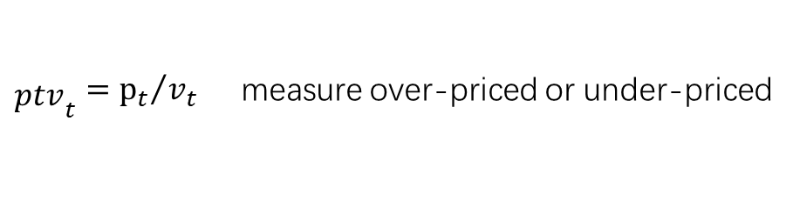
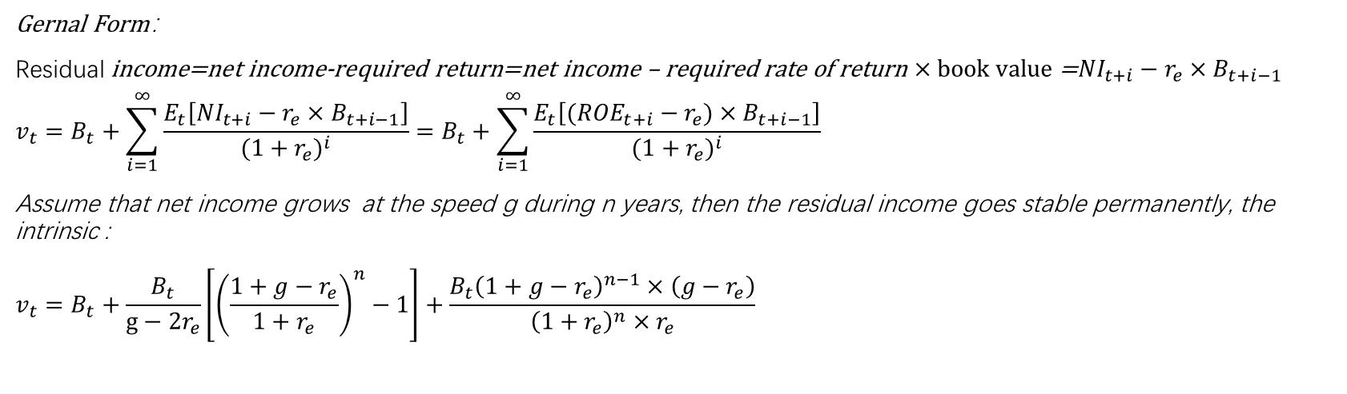
02
Factor Definition
ptv (price to value index):
${\begin{aligned} \\ ptv\end{aligned}}_{t}={p_{t}}/{v_{t}}$ measure over-priced or under-priced
Intrinsic Value: Residual Income Model
Gernal Form：
$$\text{Residual} \text{income}\text{=}\text{net} \text{income}\text{−}\text{required} \text{return}\text{=}\text{net} \text{income}\text{ – }\text{required} \text{rate} \text{of} \text{return}×book value\text{ =}{NI}_{t+i}−r_{e}×B_{t+i−1}$$
$$v_{t}=B_{t}+\sum_{i=1}^{∞}{\frac{E_{t}\left[{NI}_{t+i}−r_{e}×B_{t+i−1}\right]}{{(1+r_{e})}^{i}}}=B_{t}+\sum_{i=1}^{∞}{\frac{E_{t}\left[({ROE}_{t+i}−r_{e})×B_{t+i−1}\right]}{{(1+r_{e})}^{i}}}$$
Assume that net income grows at the speed g during n years, then the residual income goes stable permanently, the intrinsic :
$$v_{t}=B_{t}+\frac{B_{t}}{g−2r_{e}}\left[{\left(\frac{1+g−r_{e}}{1+r_{e}}\right)}^{n}−1\right]+\frac{B_{t}{\left(1+g−r_{e}\right)}^{n−1}×\left(g−r_{e}\right)}{{\left(1+r_{e}\right)}^{n}×r_{e}}$$

Slide 8
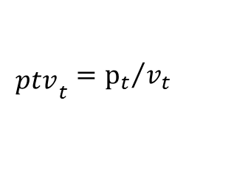
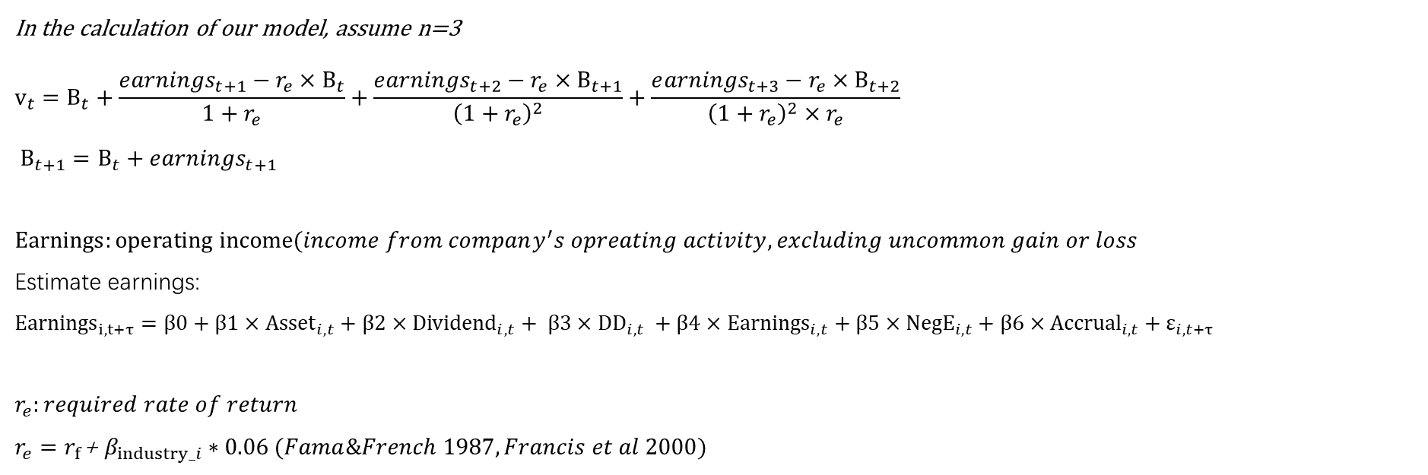
02
Factor Definition
In the calculation of our model, assume n=3
$$v_{t}=B_{t}+\frac{e{arnings}_{t+1}−r_{e}×B_{t}}{1+r_{e}}+\frac{e{arnings}_{t+2}−r_{e}×B_{t+1}}{{\left(1+r_{e}\right)}^{2}}+\frac{e{arnings}_{t+3}−r_{e}×B_{t+2}}{{\left(1+r_{e}\right)}^{2}×r_{e}}$$
$$B_{t+1}=B_{t}+e{arnings}_{t+1}$$
$$Earnings:operating income(income from company^{′}s opreating activity, excluding uncommon gain or loss$$
Estimate earnings:
$${Earnings}_{i,t+τ}=β0+β1×{Asset}_{i,t}+β2×{Dividend}_{i,t}+ β3×{DD}_{i,t} +β4×{Earnings}_{i,t}+β5×{NegE}_{i,t}+β6×{Accrual}_{i,t}+ε_{i,t+τ }$$
$$r_{e}:required rate of return$$
$r_{e}=$ $r_{f}$+ $β_{industry_i}∗0.06 (Fama\&French 1987, Francis et al 2000)$
ptv (price to value index):
$${\begin{aligned} \\ ptv\end{aligned}}_{t}={p_{t}}/{v_{t}}$$

Slide 9
03
Why factor works

Slide 10

03
Why factor works
Fama-MacBeth regression
Looking the p-value of the βs , we can find whether the coefficients of each factor is significantly different form 0, which means if the factor is valid or not.

Slide 11
03
Why factor works
Dep. Variable: | monthly_return
Estimator: | FamaMacBeth
No. Observations: | 732193
Cov. Estimator: | Fama-MacBeth Standard Cov
F-statistic: | 7.697e+04
Entities: | 2469
Avg Obs: | 296.55
Min Obs: | 18.000
Max Obs: | 942.00
P-value | 0.0000
Time periods: | 384
Avg Obs: | 1906.8
Min Obs: | 127.00
Max Obs: | 2469.0
R-squared: | 0.3445
R-squared (Between): | 0.6144
R-squared (Within): | 0.3380
R-squared (Overall): | 0.3445
Log-likelihood | 5.44e+05
P-value | 0.0000
Distribution: | F(5,732187)
F-statistic (robust): | 3980.3
Distribution: | chi2(5)
Fama-MacBeth
Regression Summary

Slide 12
03
Why factor works
 | Parameter | Std. Err. | T-stat | P-value | Lower CI | Upper CI
const | -0.0192 | 0.0051 | -3.7452 | 0.0002 | -0.0293 | -0.0092
ptv | -0.0002 | 9.814e-05 | -2.4019 | 0.0163 | -0.0004 | -4.337e-05
momentum | 0.0849 | 0.0015 | 57.446 | 0.0000 | 0.0820 | 0.0878
turnover | -0.0049 | 0.0003 | -18.429 | 0.0000 | -0.0054 | -0.0044
size | 8.88e-05 | 0.0003 | 0.2973 | 0.7662 | -0.0005 | 0.0007
PE | 0.0002 | 5.609e-05 | 4.0024 | 0.0001 | 0.0001 | 0.0003
Parameter Estimates for
Fama-MacBeth regression

Slide 13
Stock selection & Portfolio calculation
04

Slide 14
04
Stock selection & Portfolio calculation
Portfolio Formation
At the beginning of each month, calculate factor value for every stock
Choose 5 stock with minimum factor value
1
2
Hold these shares until the next month
4
3
Invest in these stocks with market value as weight

Slide 15
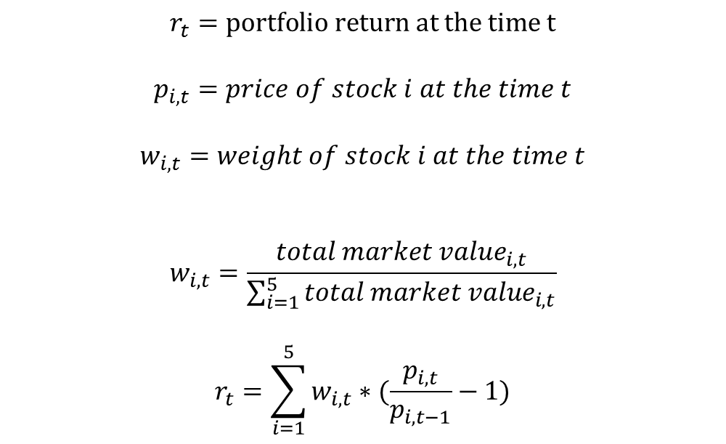
04
Stock selection & Portfolio calculation
We assume there is no any transaction cost.
That’s a limitation of our project. We will improve this part in next project.
$$r_{t}=portfolio return at the time t$$
$$p_{i,t}=price of stock i at the time t$$
$$w_{i,t}=weight of stock i at the time t$$
$$w_{i,t}=\frac{{total market value}_{i,t}}{\sum_{i=1}^{5}{{total market value}_{i,t}}}$$
$$r_{t}=\sum_{i=1}^{5}{w_{i,t}∗(\frac{p_{i,t}}{p_{i,t−1}}−1)}$$
Update the portfolio value monthly

Slide 16

04
Stock selection & Portfolio calculation
Strategy 1
Strategy 2
Benchmark
Long hoding portfolio and short holding stock position in HS300, adjusting monthly
Simply holding portfolio and adjusting stock position at the beginning of each month
HS300 index

Slide 17
Result & Performance
Evaluation
05

Slide 18
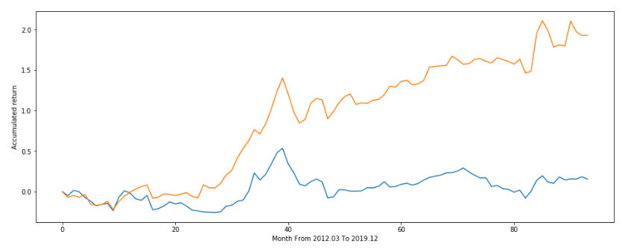
05
Result & Performance Evaluation
X: Time: Month From 2012.03 To 2019.12 | Orange: Portfolio accumulated return
Y: Accumulated return | Blue: Accumulated return of HS300

Slide 19
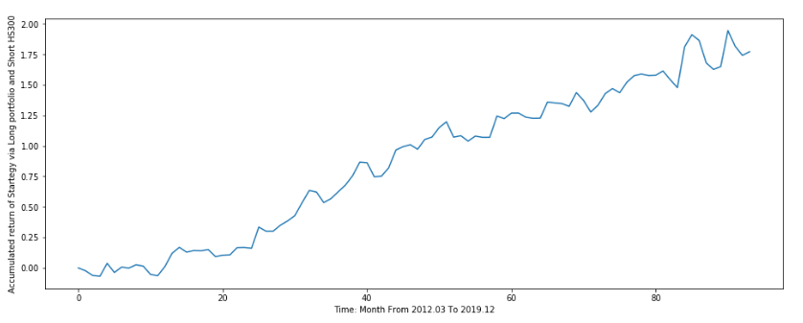
05
Result & Performance Evaluation
Accumulated return of Startegy via Long portfolio and Short HS300

Slide 20
05
Result & Performance Evaluation
1
Annual Return
2.
2
Sharp ratio
Evaluation criterion
3.
3
Maximum drawdown

Slide 21
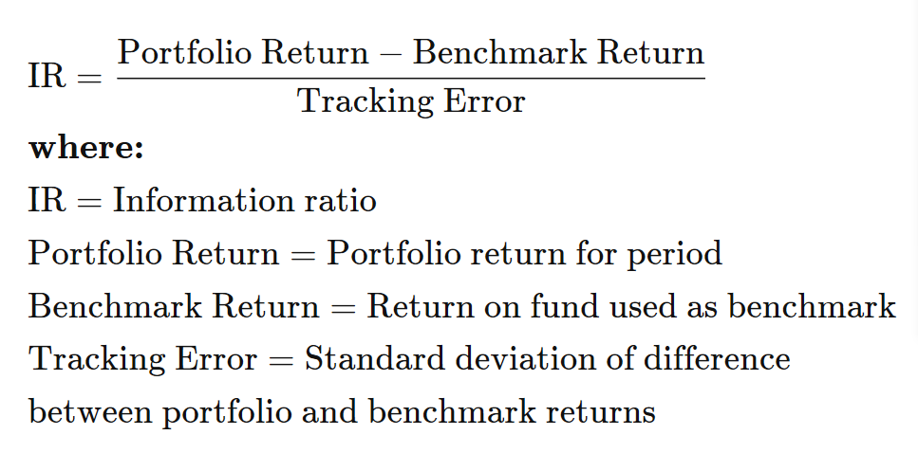
05
Result & Performance Evaluation
Index | Value
Annual return of HS300 | 0.0196
Annual return of Portfolio | 0.2458
Annual return of Startegy of Long Portfolio and Short HS300 | 0.2262
information ratio of Portfolio | 0.2408

Slide 22
05
Result & Performance Evaluation
Index | Value
Sharp ratio of Portfolio | 0.24083469
Sharp ratio of benchmark HS300 | -0.08608367
Sharp ratio of Startegy of Long Portfolio and Short HS300 | 0.68674876

Slide 23
05
Result & Performance Evaluation
Index | Value
Monthly Maximum drawdown of Portfolio | -0.2335
Monthly Maximum drawdown of HS300 | -0.1958
Monthly Maximum drawdown of Long Portfolio and Short HS300 | -0.1849

Slide 24
Reference
Balakrishnan K． ，E． Bartov，L． Faurel． 2010． Post Loss/ Profit Announcement Drift． Journal of Accounting and Econom- ics，50: 20 ～ 41
Bradshaw，M． T． 2004． How Do Analysts Use Their Earnings Forecasts in Generating Stock Recommendations? The Accounting Review，79: 25 ～ 50
Cooper M． J． ，H． Gulen，M． J． Schill． 2008． Asset Growth and the Cross － section of Stock Returns． Journal of Fi- nance，63: 1609 ～ 1651
Dechow P． ，A． Hutton，R． Sloan． 1999． An Empirical Assessment of the Residual Income Valuation Model． Journal of Accounting Economics，26: 1 ～ 34
Fama E． F． ，K． R． French． 2000． Forecasting Profit- ability and Earnings． Journal of Business，72: 161 ～ 175
Francis J． ，P． Olsson，D． Oswald． 2000． Comparing the Accuracy and Explainability of Dividend，Free Cash Flow and Abnormal Earnings Equity Valuation Models，Journal of Ac- counting Research，38: 45 ～ 70

Slide 25
Code and Data
Code and Data can be downloaded from:
https://github.com/king-yellow/PTV_Group_factor_project/tree/master

Slide 26
Thank You

